Slide 1
Object Detection Project
Project Overview:
This project focuses on developing a robust car direction detection system capable of classifying images into four categories: Left Turn, Right Turn, Go Straight, and Unexpected Road. Leveraging a custom dataset, the model aims to enhance road safety through accurate directional predictions.

Slide 2
Model Architecture & Training
The Convolutional Neural Network (CNN) architecture comprises three convolutional layers with 32, 64, and 128 filters, respectively, each followed by max-pooling layers to extract hierarchical features from input images. The flattened representation is then fed into a fully connected layer with 256 neurons, incorporating ReLU activation for non-linearity. A dropout layer helps prevent overfitting, and the final dense layer with softmax activation yields predictions for four output classes: Left Turn, Right Turn, Go Straight, and Unexpected Road.
Model trained for 15 epochs, batch size 32
Training accuracy: 78%

Slide 3
Model Evaluation
The test accuracy of the model is 69%, indicating its performance on unseen data. It's crucial to compare this with the training accuracy of 78% to assess potential overfitting. A smaller gap between training and testing accuracy suggests better generalization, while a significant difference may indicate overfitting, demanding further evaluation and potential adjustments to the model.

Slide 4
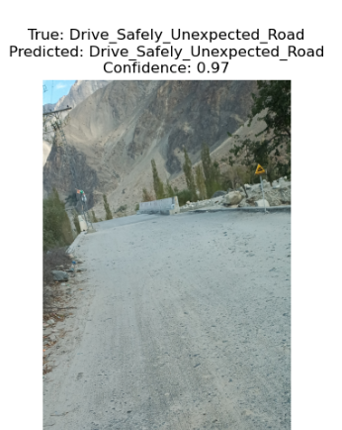
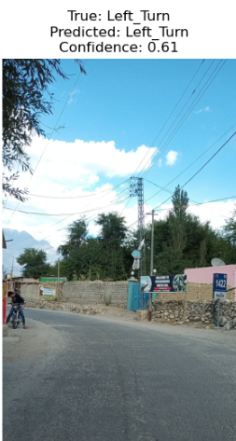
Predictions

Slide 5
Github link
https://github.com/itahamehdy

